Slide 1








Lesson 1. Two way data binding in angular 4

Slide 2
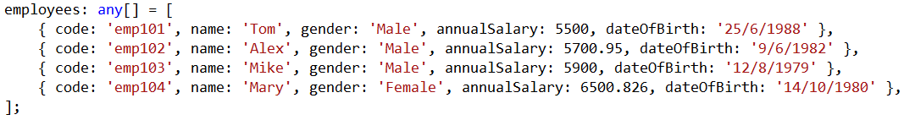
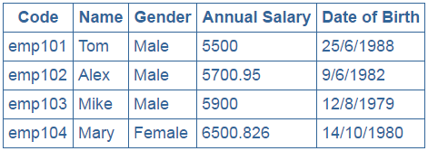
Angular ngFor Directive

Slide 3
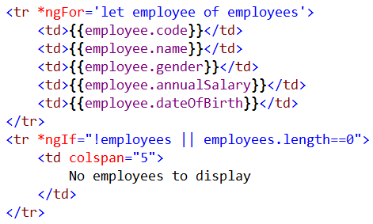
Angular ngFor Directive

Slide 4
Q & A
Contact:rashmipawaskar@synergetics-india.com

Slide 5
Thank You

